Slide 1

CS+Social Good

Slide 2

Our First Project:
Classifying Malignant Breast Cancer Tumors

Slide 3
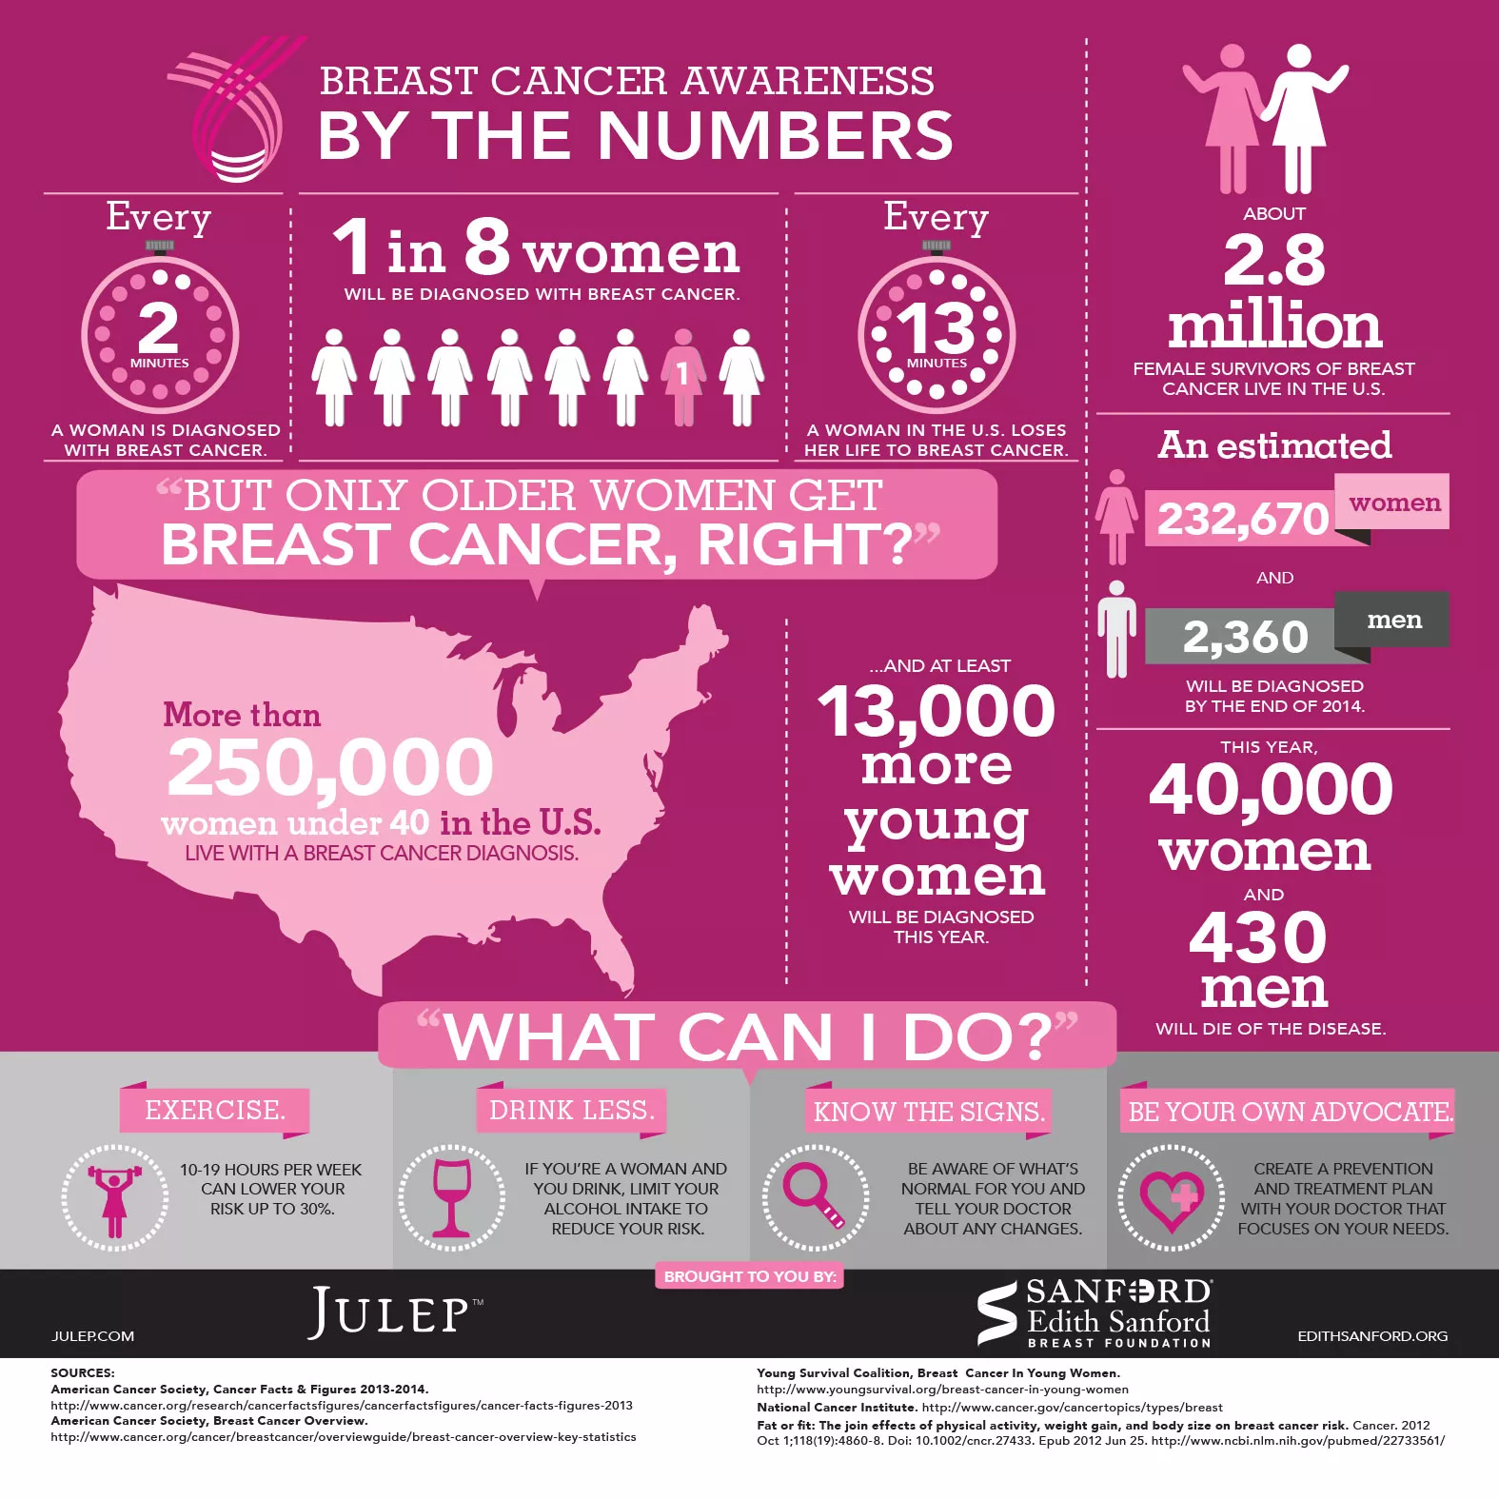
The Problem
1 in 8 women will be diagnosed with breast cancer
Doctor diagnosis is imperfect
Could miss some real tumors
Could classify benign as a tumor
Notes:
Made up of starting/closing tags and attributes

Slide 4
Our Task
Given medical data about cell growths, can we accurately classify these tumors as benign or malignant?
Notes:
Made up of starting/closing tags and attributes

Slide 5
Why does this matter?
Classifying tumors allows:
Doctors to diagnose cancer with greater accuracy
Doctors and patients to make more informed decisions Medical costs to be reduced and diagnosing processes to become more efficient
Machine learning can drop the error rate for cancer diagnoses by 85%!
Notes:
https://blogs.nvidia.com/blog/2016/09/19/deep-learning-breast-cancer-diagnosis/

Slide 6
Introduction to Machine Learning

Slide 7

What is Machine Learning?
Machine learning is a “field of study that gives computers the ability to learn without being explicitly programmed.”
-Arthur Samuel, 1959
Notes:
Made up of starting/closing tags and attributes

Slide 8
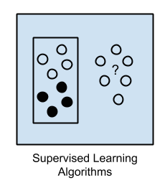
Types of Machine Learning
Supervised
Know the outcome of data
(Black or White in graphic)
Spam vs. Not Spam
Housing Price (based on sq ft, num bath, num bed)
Breast Cancer Classification
Unsupervised
Notes:
Made up of starting/closing tags and attributes

Slide 9
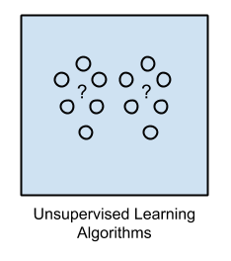
Types of Machine Learning
Supervised
Unsupervised
No outcome variable *gasp*
Knowing everyone’s friends on Facebook, tell me about the structure of friend groups
Looking at news sites to group articles into categories
Notes:
Graphics from: http://machinelearningmastery.com/a-tour-of-machine-learning-algorithms/
Made up of starting/closing tags and attributes

Slide 10
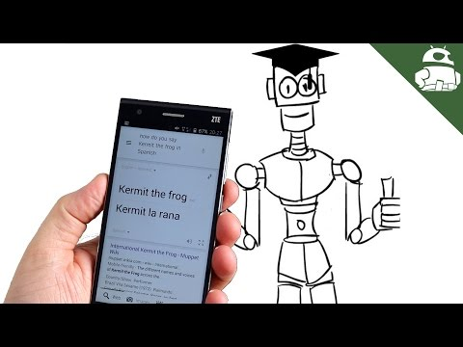
Notes:
Optional.
More overview/motivation: https://www.youtube.com/watch?v=l95h4alXfAA
More technical supervised learning:
https://www.youtube.com/watch?v=ls7Ke48jCt8&list=PLZ9qNFMHZ-A4rycgrgOYma6zxF4BZGGPW&index=3

Slide 11
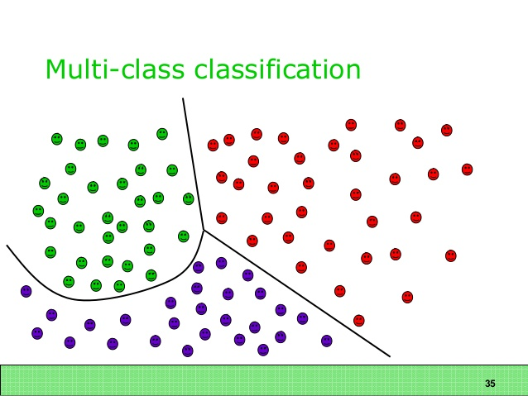
Types of Supervised Learning
Classification
One of several categories
Spam or not
Tumor or not
Letter of the alphabet
What we’ll do today!
Regression
Notes:
https://neustan.files.wordpress.com/2015/09/multiclass.jpg

Slide 12
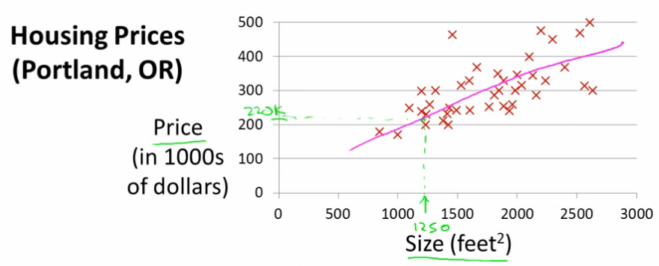
Types of Supervised Learning
Classification
Regression
Continuous outcome variable
E.x. housing prices
Notes:
http://4.bp.blogspot.com/-S11k6vJwxdc/TpDINkQ_bDI/AAAAAAAADGY/Q8t09bzT4y0/s1600/house_prices_portland.png

Slide 13
Using Data in Machine Learning
Need training data -- this will teach our algorithm what is right and wrong
Need to check our model!
Can’t use data we’ve never seen before!
Then we wouldn’t know if it’s right or wrong
Reserve some data as test data
For test data, we know the outcomes, and can check the accuracy of our model
Notes:
Run our classification model on the test data, figure out all the predictions, and see what our accuracy looks like.

Slide 14
Our data
~700 total data instances from Breast Cancer Wisconsin data set
We are training on ~630, testing on ~70
Each data instance has 11 values:
1. Sample code number id number 2. Clump Thickness 1 - 10 3. Uniformity of Cell Size 1 - 10 4. Uniformity of Cell Shape 1 - 10 5. Marginal Adhesion 1 - 10 6. Single Epithelial Cell Size 1 - 10 7. Bare Nuclei 1 - 10 8. Bland Chromatin 1 - 10 9. Normal Nucleoli 1 - 10 10. Mitoses 1 - 10 11. Class: (2 for benign, 4 for malignant)
Notes:
https://archive.ics.uci.edu/ml/datasets/Breast+Cancer+Wisconsin+(Diagnostic) (Data set here)

Slide 15
Making Predictions
The core idea of prediction:
Compare new data point to all the ones that we know about
Which ones are most similar?
The new data point will likely be the same!
This technique of looking at the K most similar points is called
K Nearest Neighbors!!!
Notes:
Find fun graphic to insert here

Slide 16
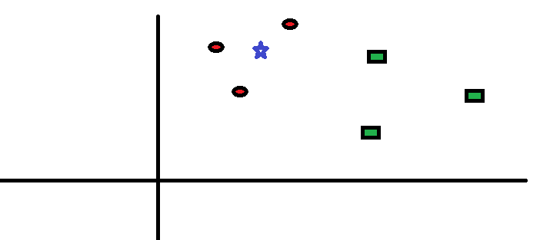
Star is unknown point. Red is tumorous, green is benign.
Notes:
Made up of starting/closing tags and attributes

Slide 17
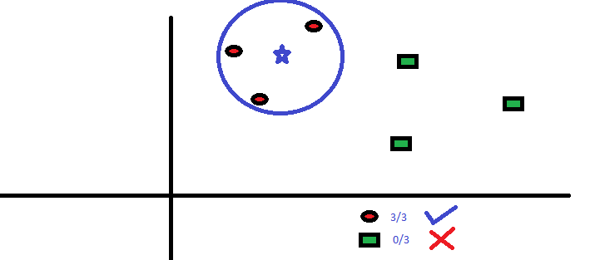
It’s 3 closest neighbors are tumors. We’ll guess it’s a cancer cell.
Notes:
Made up of starting/closing tags and attributes

Slide 18
k-nearest-neighbors
For each test instance you’d like to classify:
Step 1: Find the distances between our new instance and all existing instances
Step 2: Pick the K points that are closest
Step 3: Of these K points, see how many are malignant and how many are benign
Step 4: Pick whichever class appears more times as your answering!
Notes:
Made up of starting/closing tags and attributes

Slide 19
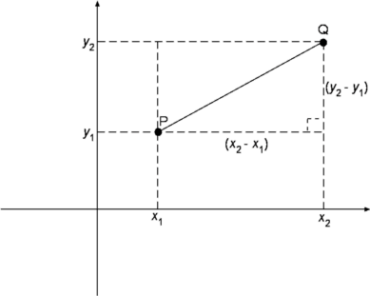
Computing Distance
Not just two variables -- but the formula is almost the same!
Take the difference for each variable and square it
Add up all of these
Take the square root of the sum!
Notes:
Made up of starting/closing tags and attributes

Slide 20

Testing Your Code
This project isn’t easy, so it’s important to test your code periodically! Every time you write ~5-10 lines of code, make sure you test it to see if it compiles and does what you want by using print statements. We’ve provided some test cases for you to check your functions.
Notes:
Made up of starting/closing tags and attributes

Slide 21
Let’s Get Started!
Notes:
Made up of starting/closing tags and attributes

Slide 22
CS+Social Good
With materials borrowed from CS106S

